Slide 1
Mini Project 1
Determining the relationship of unemployment and interest rate with the inflation.
Rojesh Dhakal

Slide 2
Business Context
Nz Herald: Seventy thousand people, roughly equivalent to the population of Rotorua, are forecast to lose their jobs
Insight global: Nearly four of every five American workers (78%) are worried about their job security.
Is it a good idea to save during inflation to get better interest rate.

Slide 3
Business Question
Is there any significant relationship between inflation and unemployment.
Is there any significant relationship between inflation and interest rate.

Slide 4
Importance of Question
Prepare
Informed decision

Slide 5
Data Pipeline
Data Acquisition
Data
Exploration
Data
Visualization
Hypothesis
Testing
Summary

Slide 6
Data Overview
Data Source: https://data.worldbank.org
21 years data of New Zealand from 1998-2018.
Focus on four columns: Year, Inflation, Interest Rate & Unemployment

Slide 7
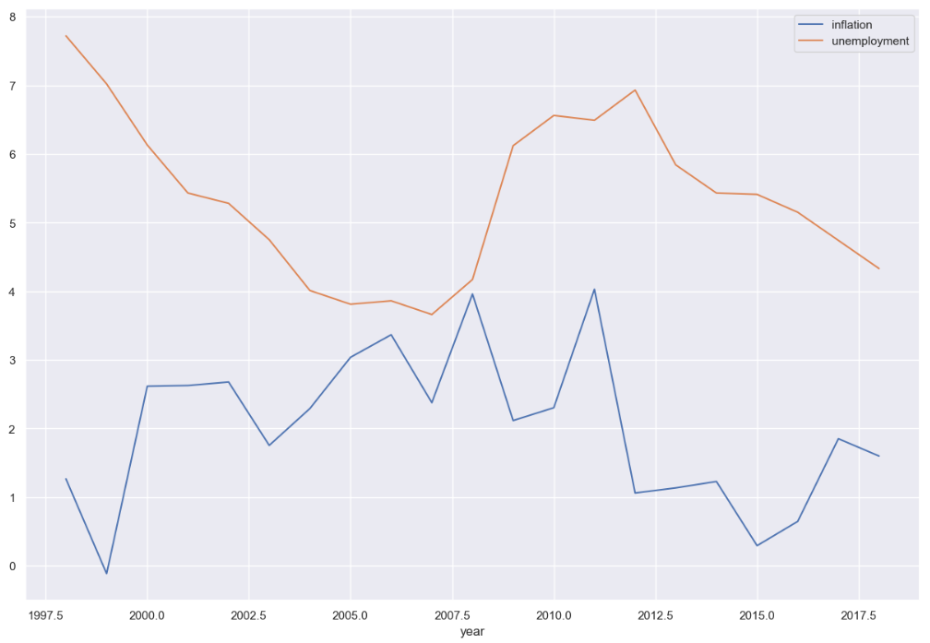
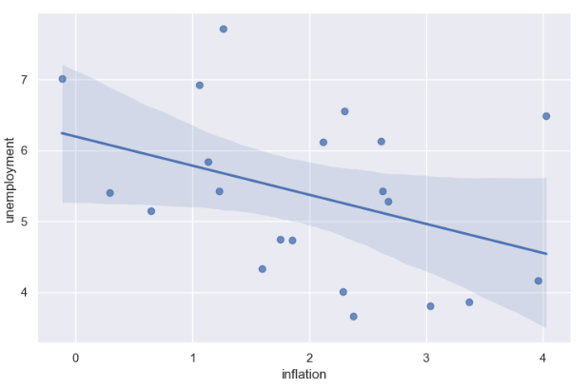
EDA of inflation and unemployment
1
2

Slide 8
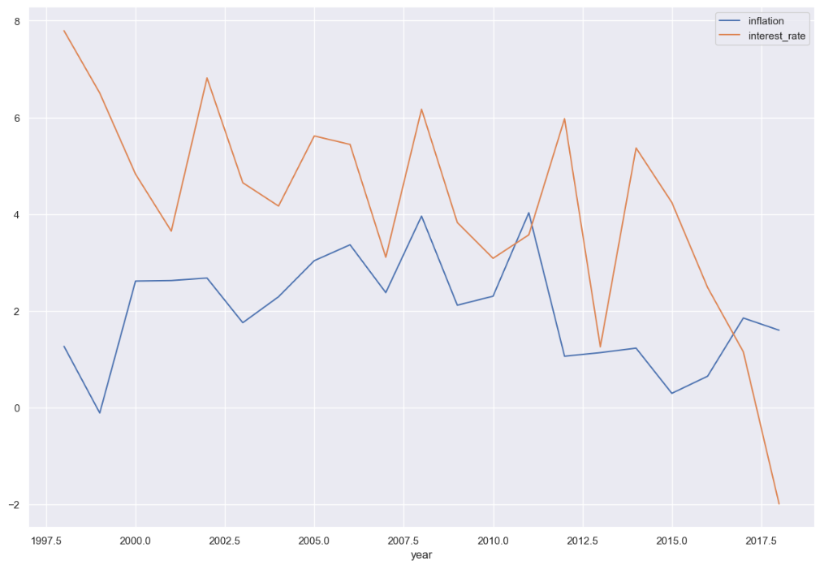
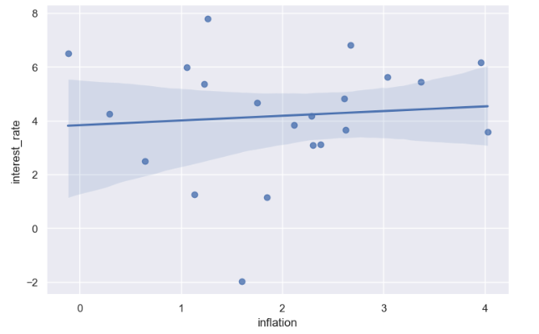
EDA of inflation and interest rate
1
2

Slide 9
Hypothesis Test
Question: What is the relationship between inflation and unemployment?
H0: There is no significant relationship between inflation and unemployment.
H1: There is significant relationship between inflation and unemployment.
Alpha=0.05
P-value= 7.15e-12
Result= Reject null hypothesis

Slide 10
Hypothesis Test
Question: What is the relationship between inflation and interest-rate?
H0: There is no significant relationship between inflation and interest rate.
H1: There is significant relationship between inflation and interest rate.
Alpha=0.05
P-value= 0.00028
Result= Reject null hypothesis

Slide 11
Next Steps
Further analysis: Linear/Logistic Regression
Modelling

